Slide 1
Forcing Encryption to S3

Slide 2
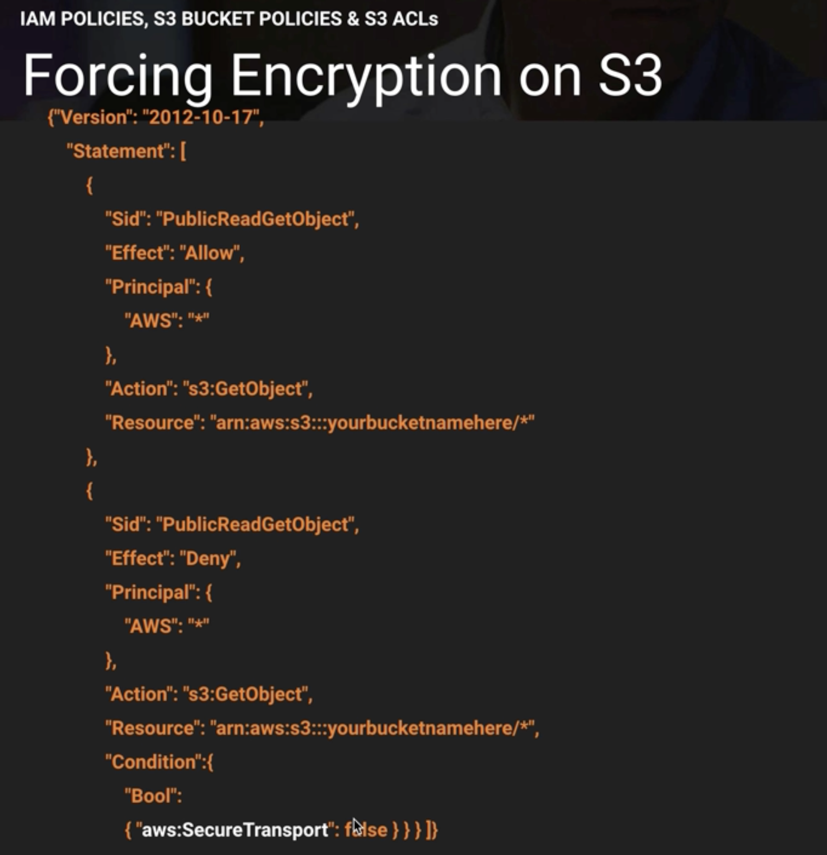

Slide 3
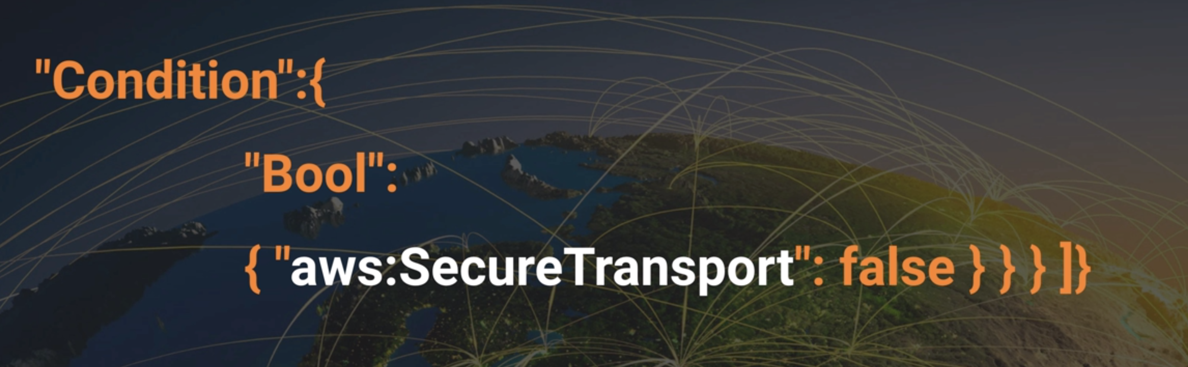

Slide 4
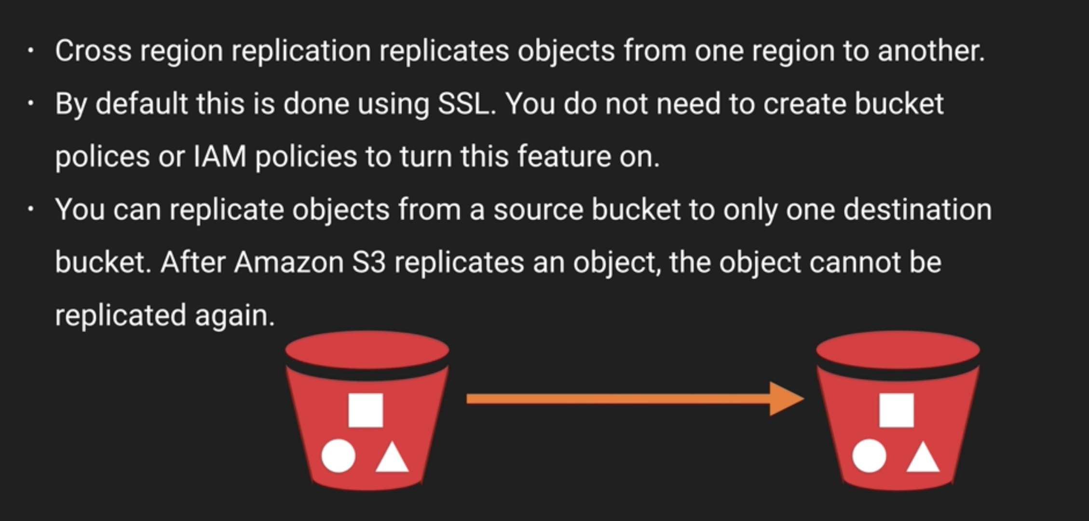
Cross Region Bucket Policy

Slide 5
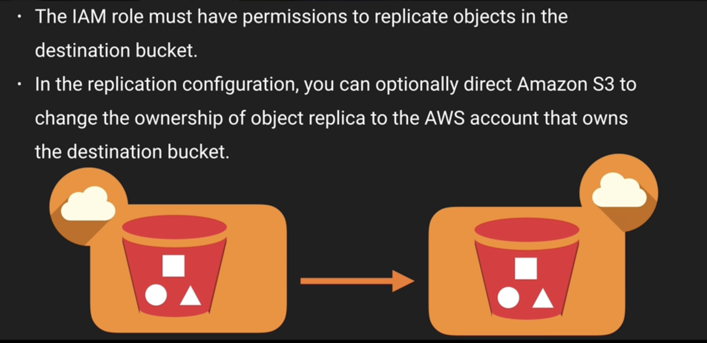
Cross Region Replication Cross Accounts

Slide 6
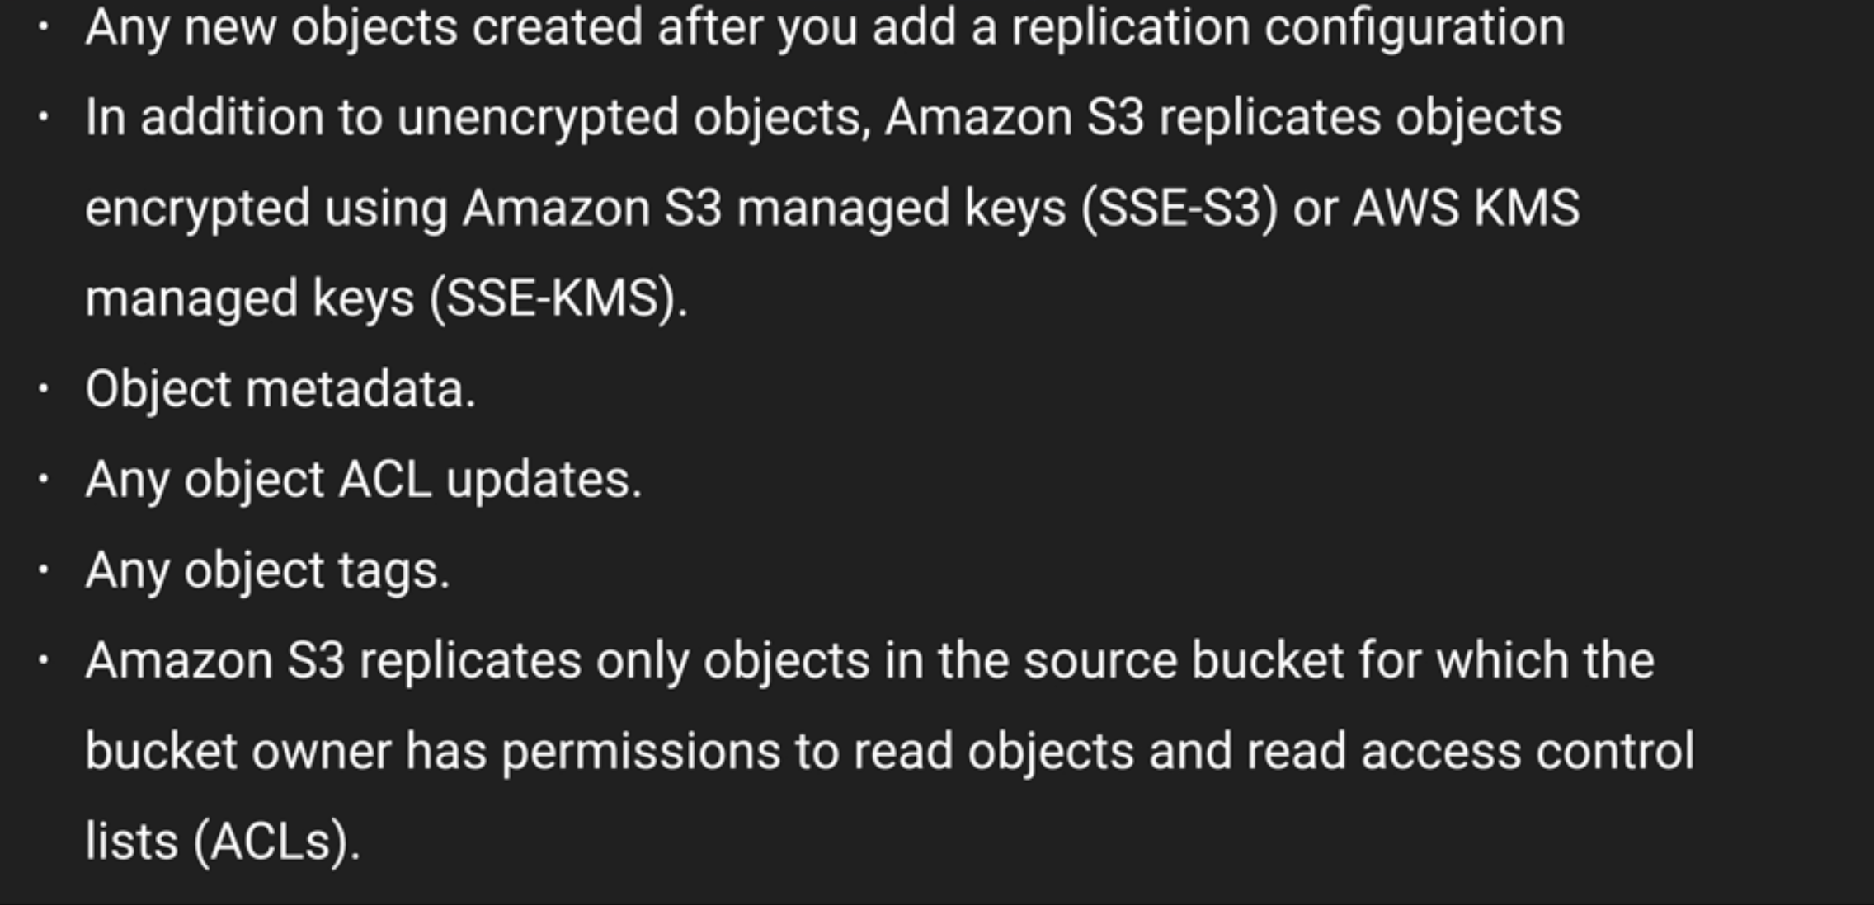
What is Replicated?

Slide 7
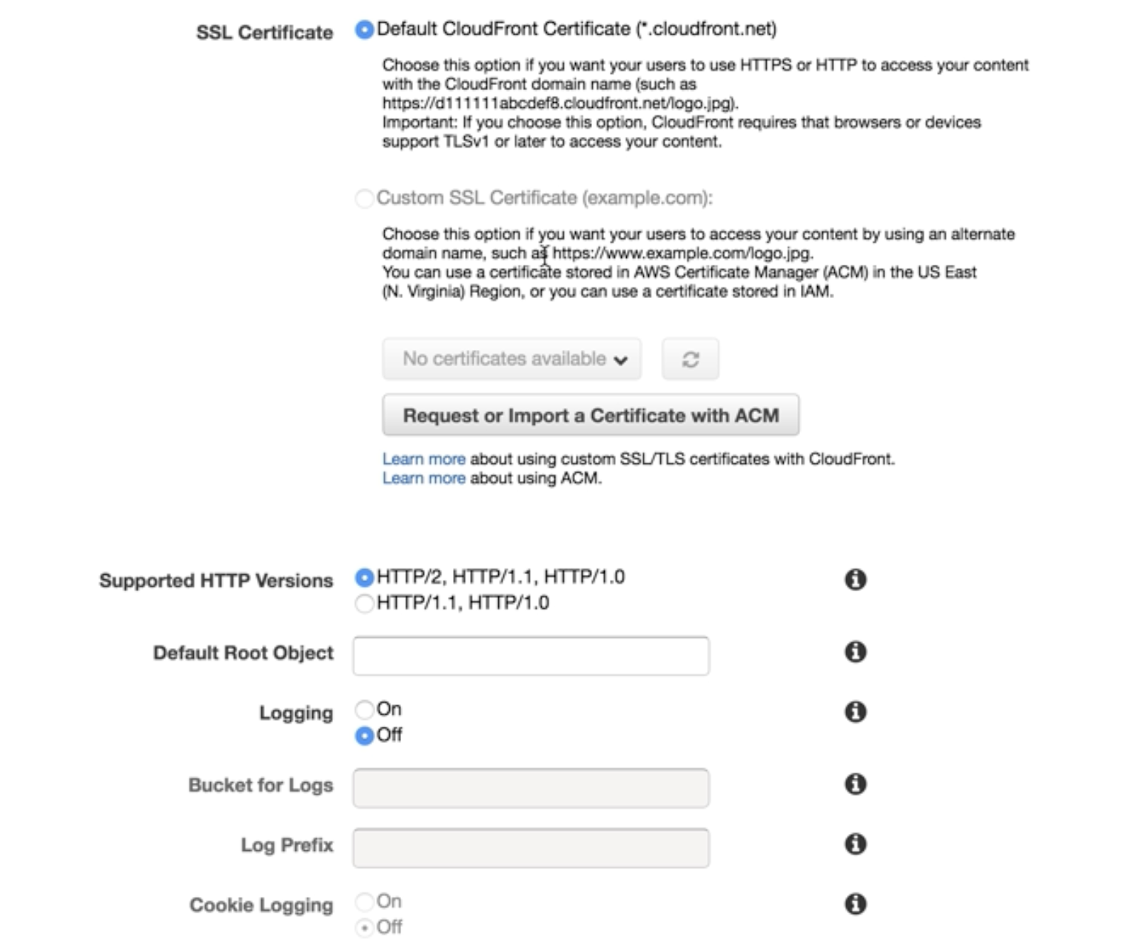
Securing S3 Use CloudFront
Create new Bucket
Go to Cloudfront
Click Create Distribution and select Origin Domain Name
Note:
If you use Custom SSL Certificate, then need to import ACM and registered.
For Example: https://www.abc.com/test.jpg

Slide 8
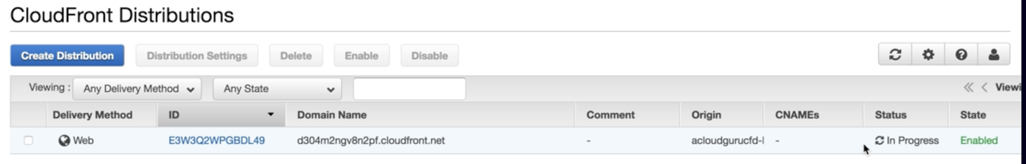

Slide 9
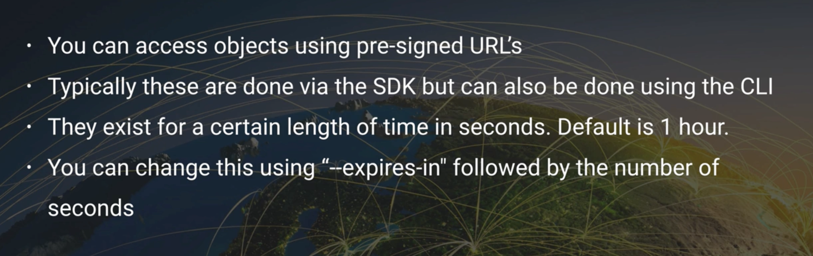
Securing S3 PreSigned URL

Slide 10
Steps:
Create IAM Role
Select EC2 and Click Next Permission
Attach Permission Policies – Amazon S3FullAccess
Type Role Name and Click Create Role
Go to EC2 Service
Click on Launch Instance
Select IAM Role(select iam role created)
Once EC2 instance created then do
> ssh –i <pemfile> ec2-user@<ip-address>
ec2-user]# sudo su
ec2-user]# aws s3 ls (see If IAM role is working)

Slide 11
ec2-user]# aws s3 mb s3://guvipresigned
ec2-user]# echo “Hello Guvi tech” > hello.txt
ec2-user]# ls
ec2-user]# aws s3 cp hello.txt s3://guvipresigned
ec2-user]# aws s3 ls s3://guvipresigned
Go to S3 service
Go to file(hello.txt) and open the file. Its giving error because by default it private.
ec2-user]# aws s3 presign s3://guvipresigned/hello.txt --expires-in 300
We can copy and paste URL in browser. Its working now.

Slide 12
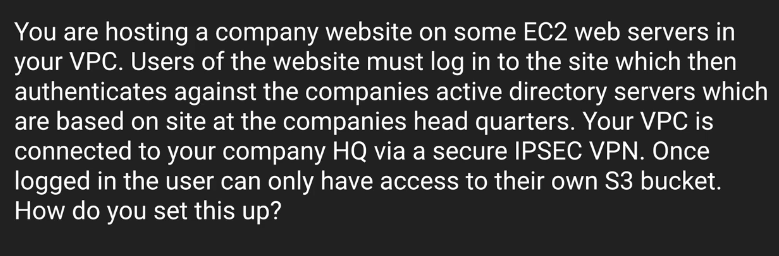
STS (Secure Token Service)
Scenarios

Slide 13
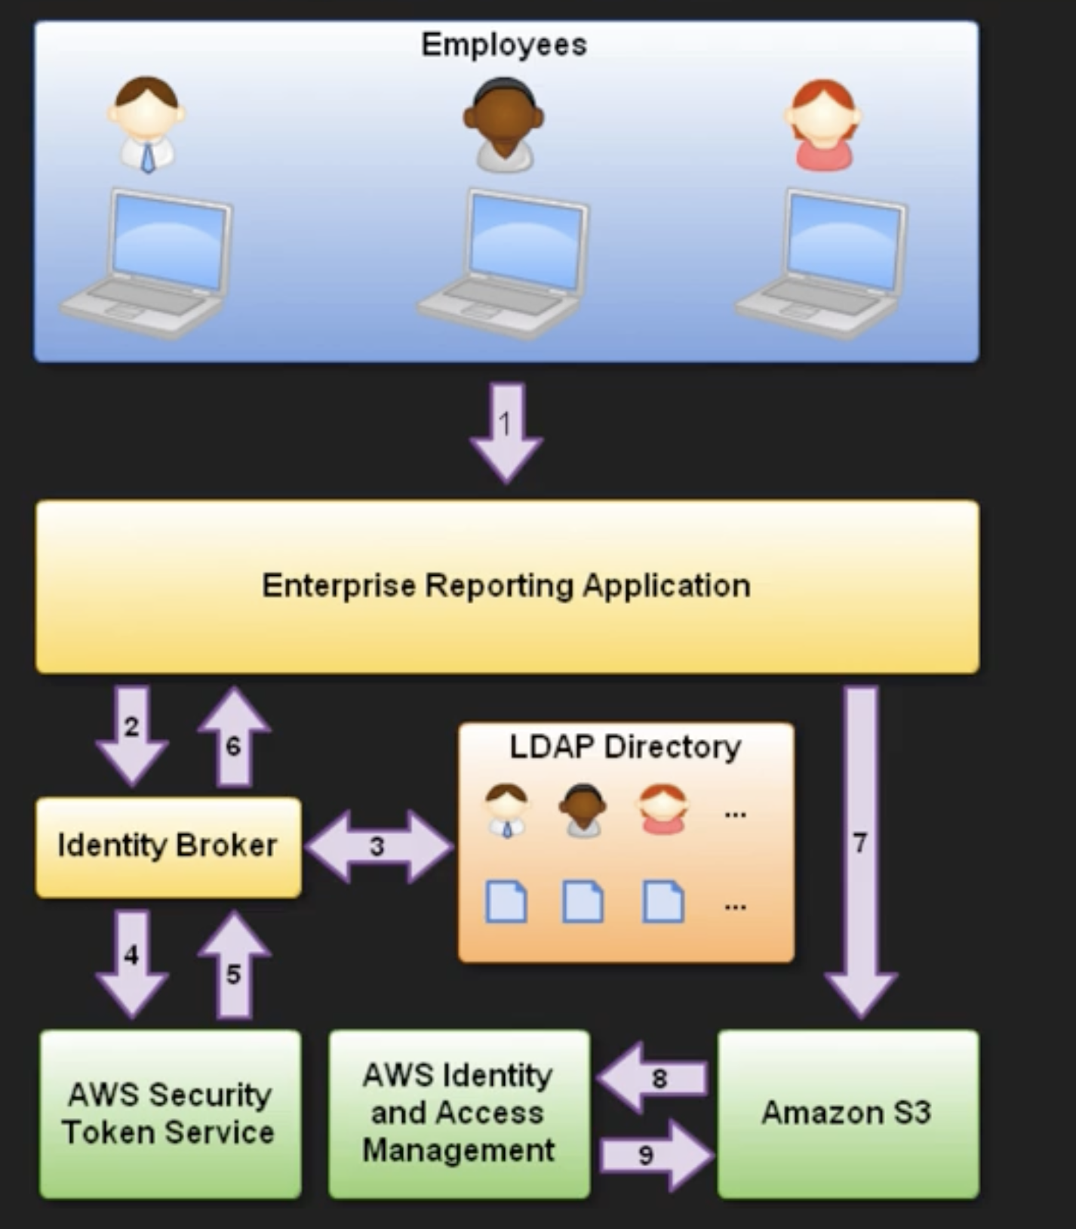
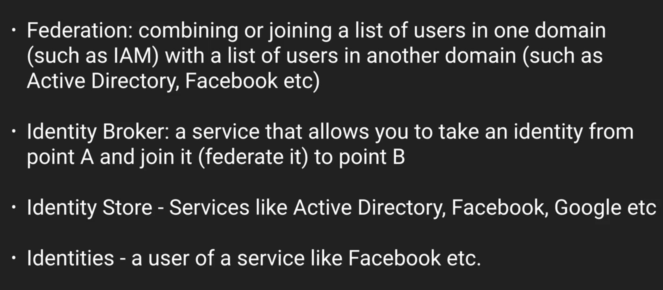

Slide 14
Logging and Monitroing
CloudWatch
Cloud Trail

Slide 15
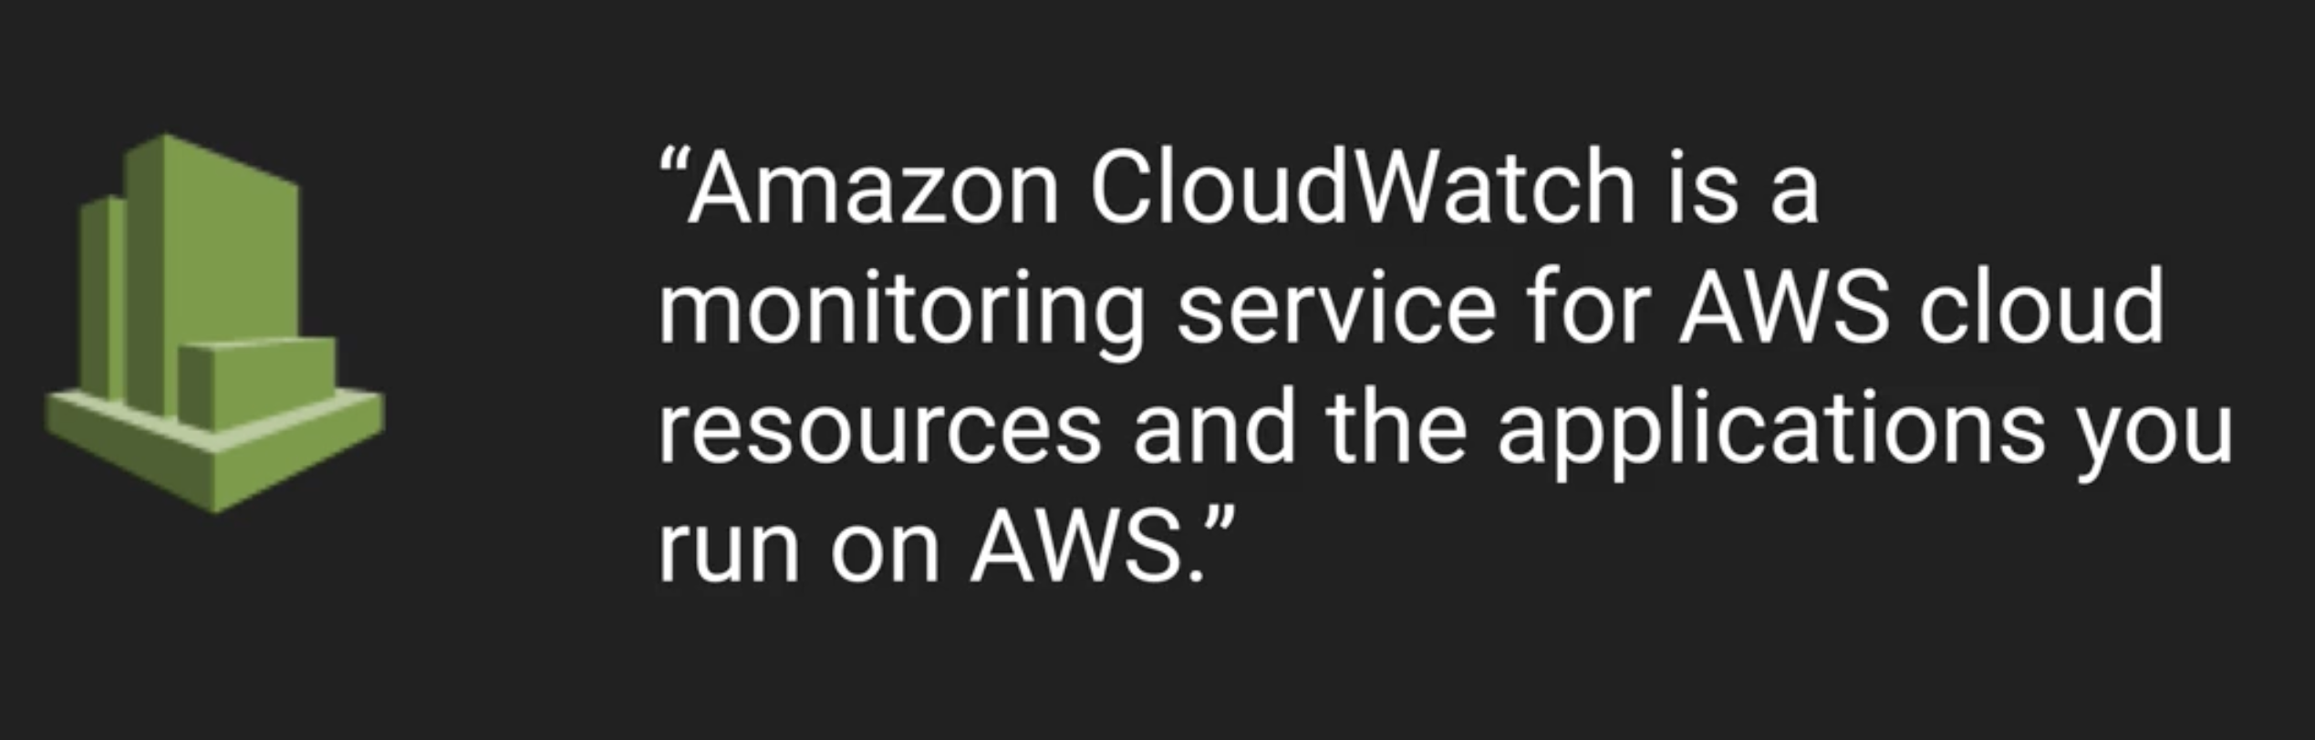
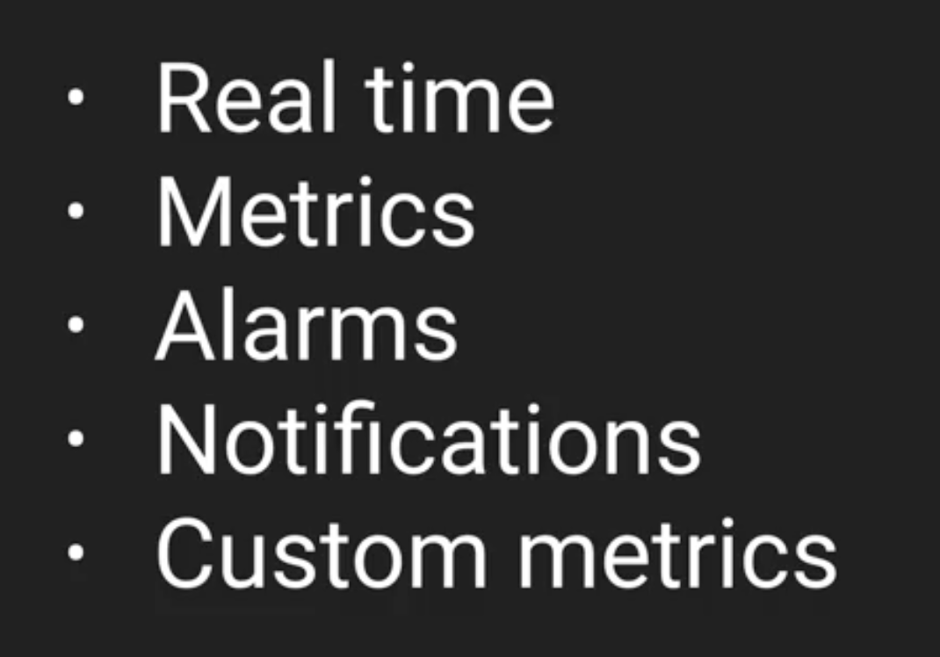
CloudWatch

Slide 16
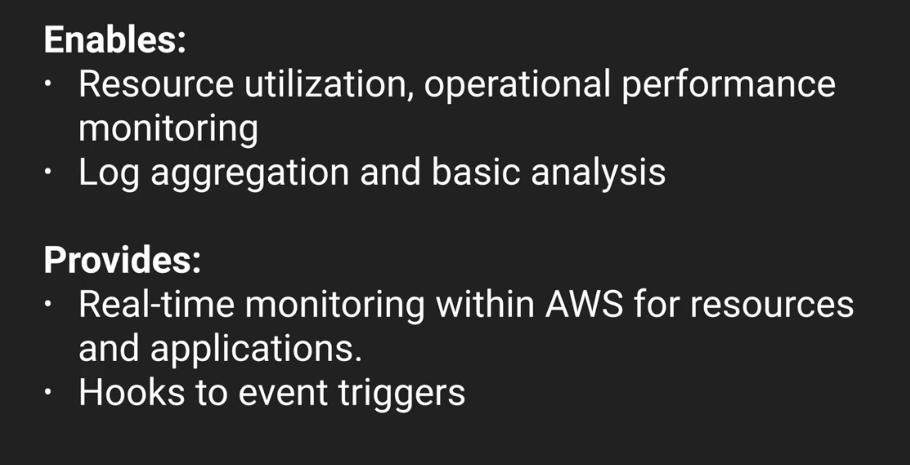

Slide 17
Go Cloudwatch Service
Create Dashboard
Select Metrics -> EC2 -> CPU Utilization
Create Alarm -> select EC2 Instancs -> whenever CPU Utilization > 80% -> Trigger Alarm
Create Rule
Select event source -> Add target -> lambda
Schedule event

Slide 18
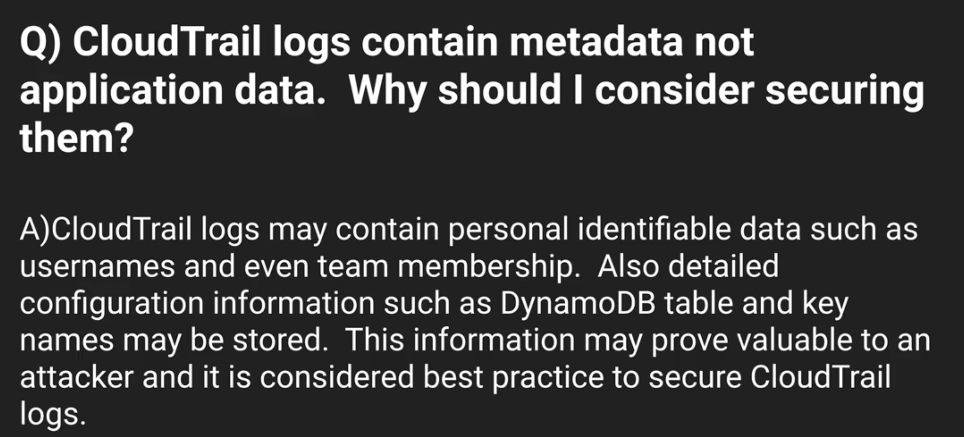
Cloud Trail

Slide 19
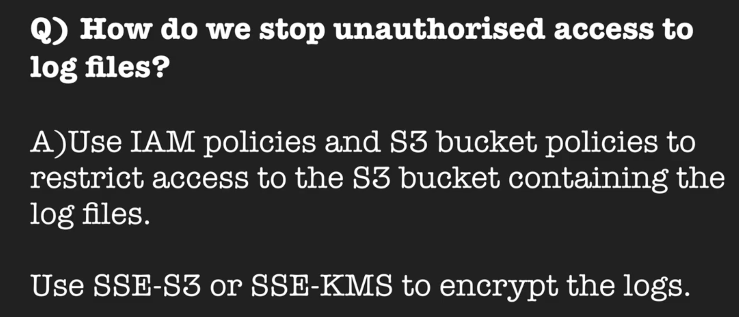

Slide 20
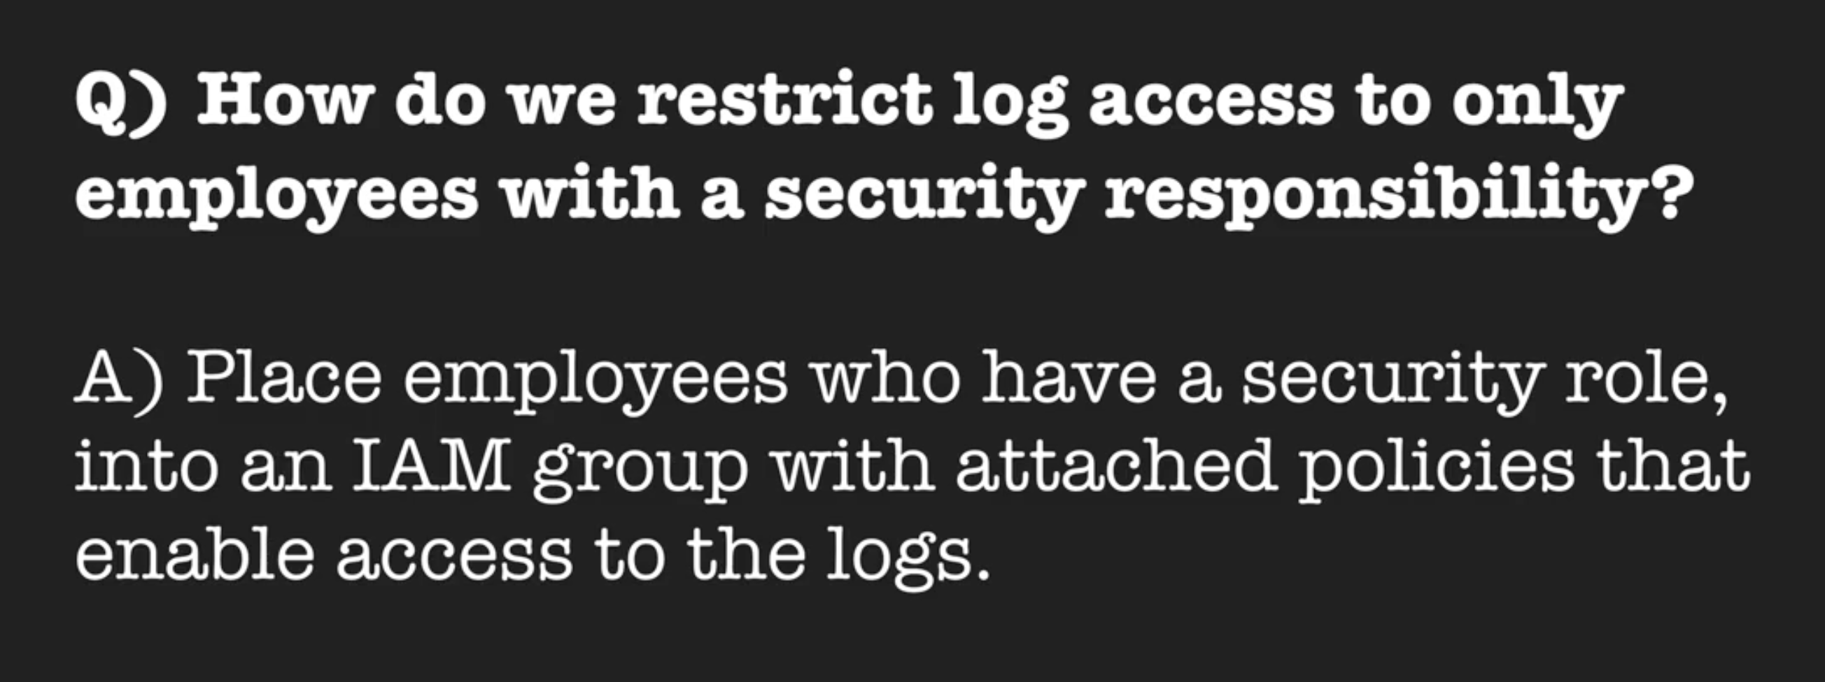

Slide 21
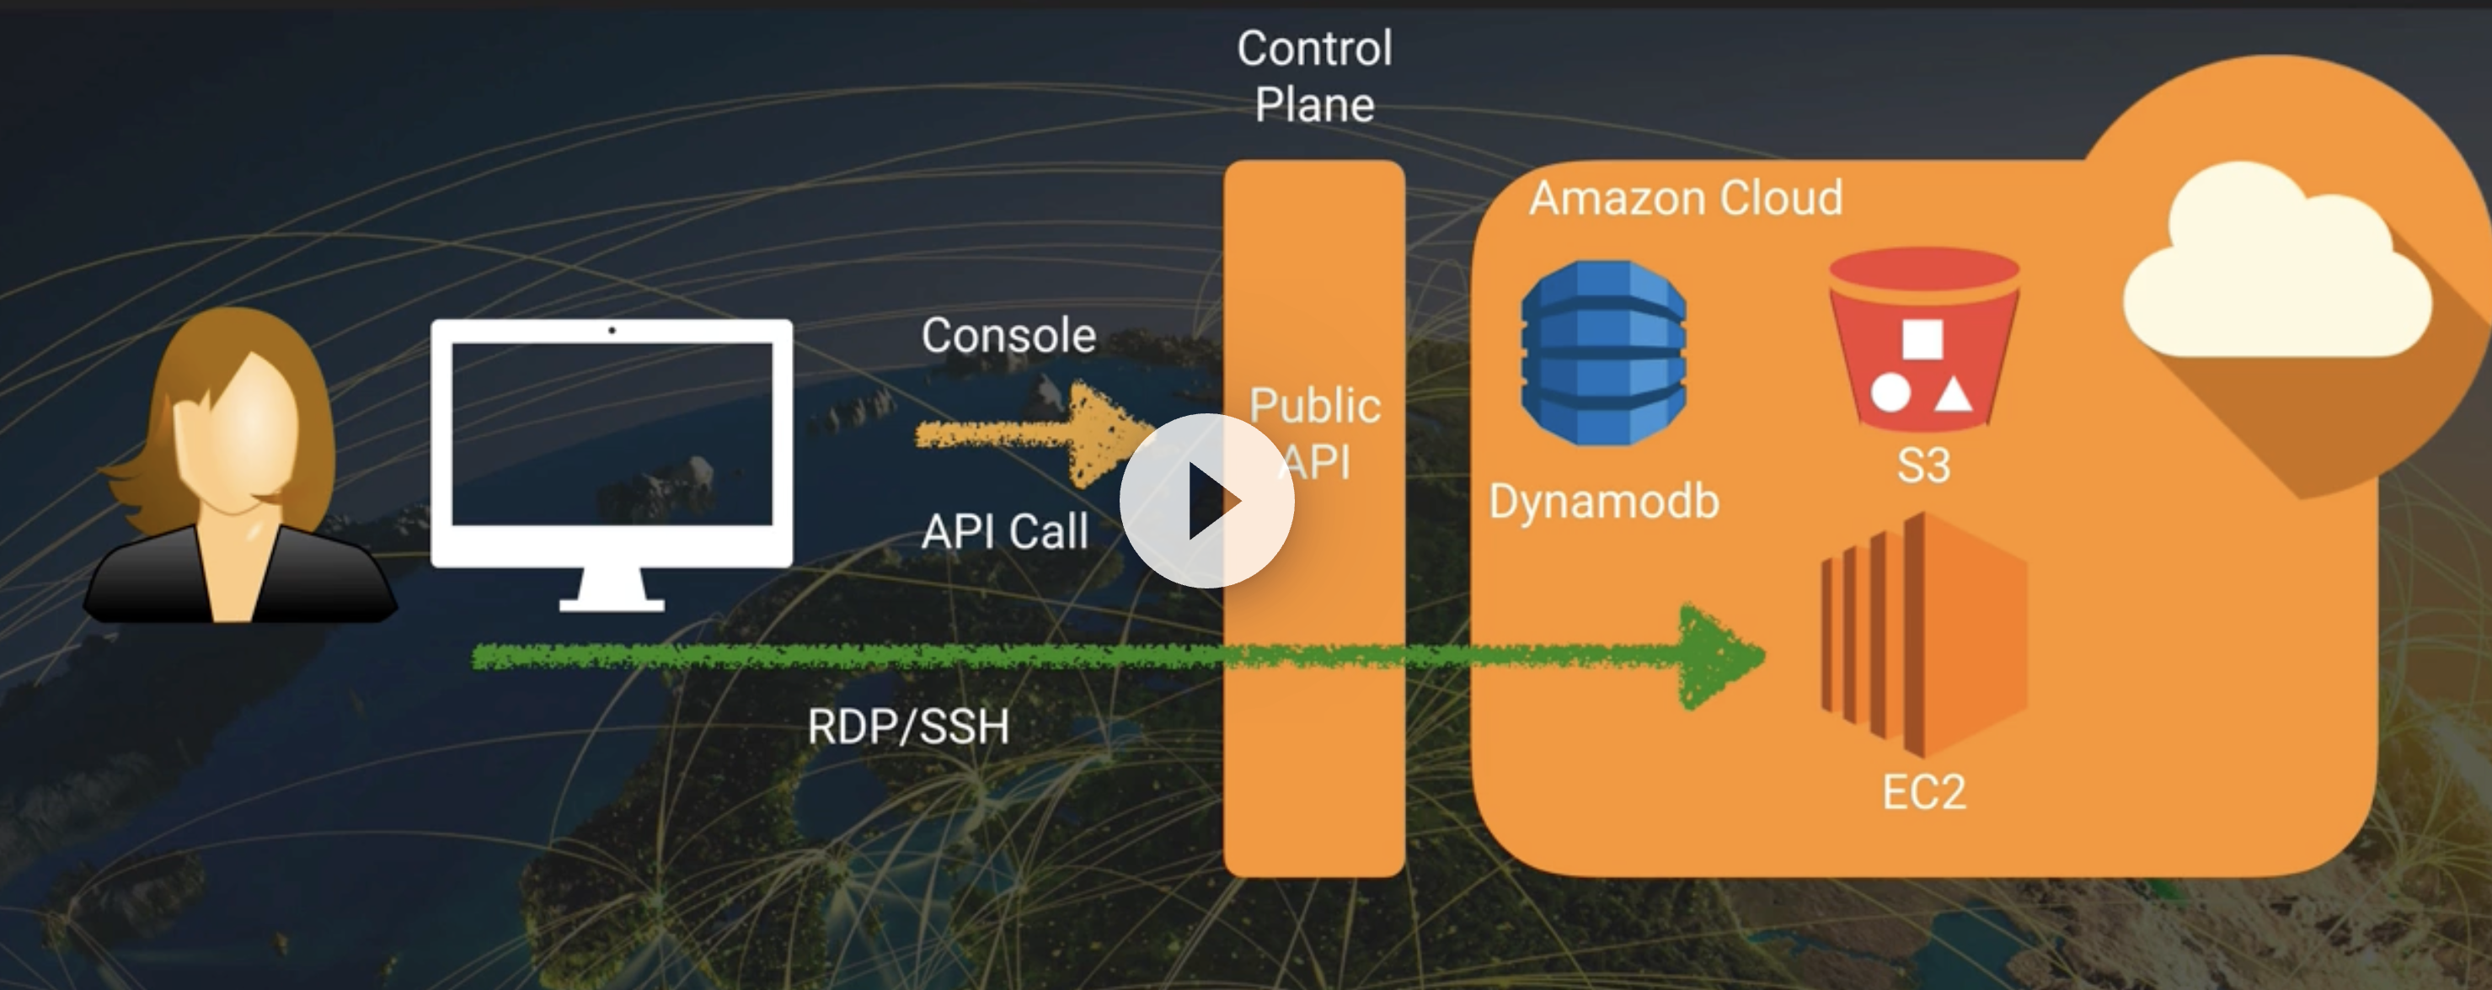

Slide 22
AWS Config
AWS Config is a fully managed service provided by Amazon Web Services (AWS) that helps you assess, audit, and evaluate the configuration of your AWS resources. It enables you to track changes to your AWS resources and determine the compliance status of your resources against your organization's policies.
AWS Config captures configuration details of your AWS resources and provides a detailed inventory of all the resources within your AWS account. It also continuously monitors the configuration of your resources and alerts you when it detects any changes or potential security risks.

Slide 23
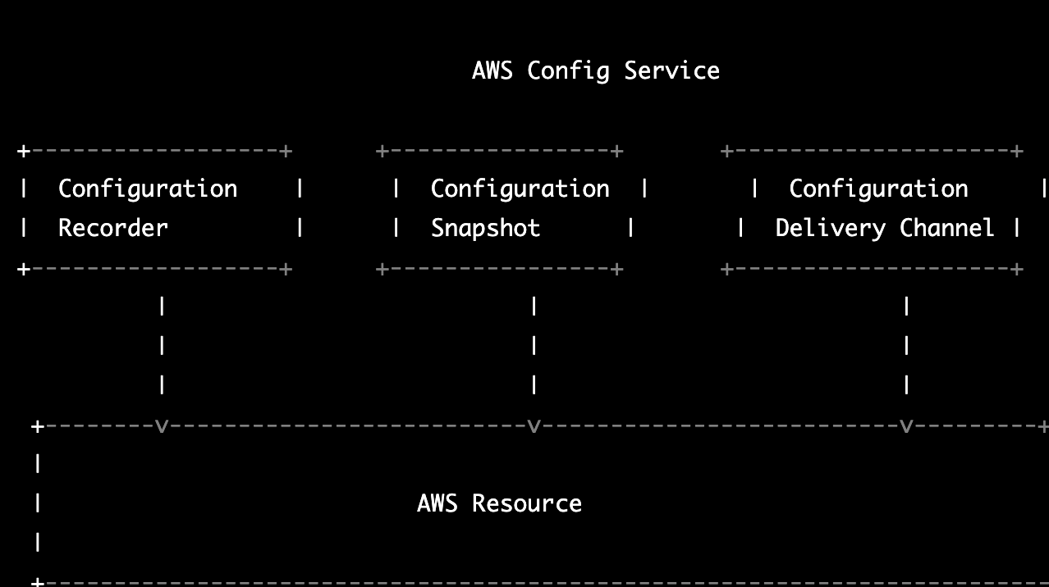
High Level Diagram(HLD)

Slide 24
Cloud HSM
AWS CloudHSM is a cloud-based hardware security module (HSM) that enables you to generate and use your own encryption keys in the cloud. An HSM is a hardware device that provides secure key storage and cryptographic operations. It is typically used in high-security applications where encryption keys must be protected from unauthorized access or tampering.
AWS CloudHSM is designed to meet regulatory and compliance requirements, such as those for HIPAA, PCI DSS, and FIPS 140-2 Level 3. It integrates with other AWS services, such as Amazon S3, Amazon RDS, and Amazon Redshift, to enable you to use your own keys for encrypting data stored in those services.
Overall, AWS CloudHSM provides a secure and compliant way to generate and use encryption keys in the cloud. It enables you to maintain control over your keys and helps you meet regulatory and compliance requirements.

Slide 25
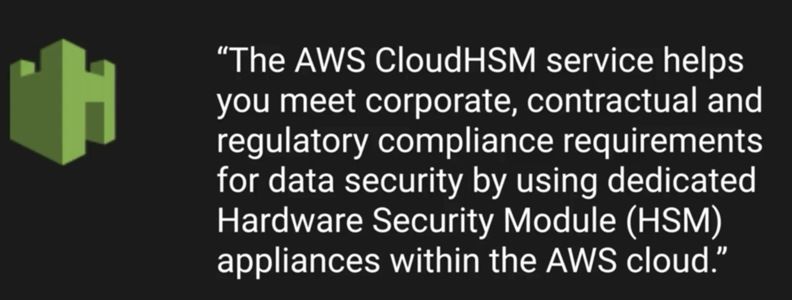

Slide 26
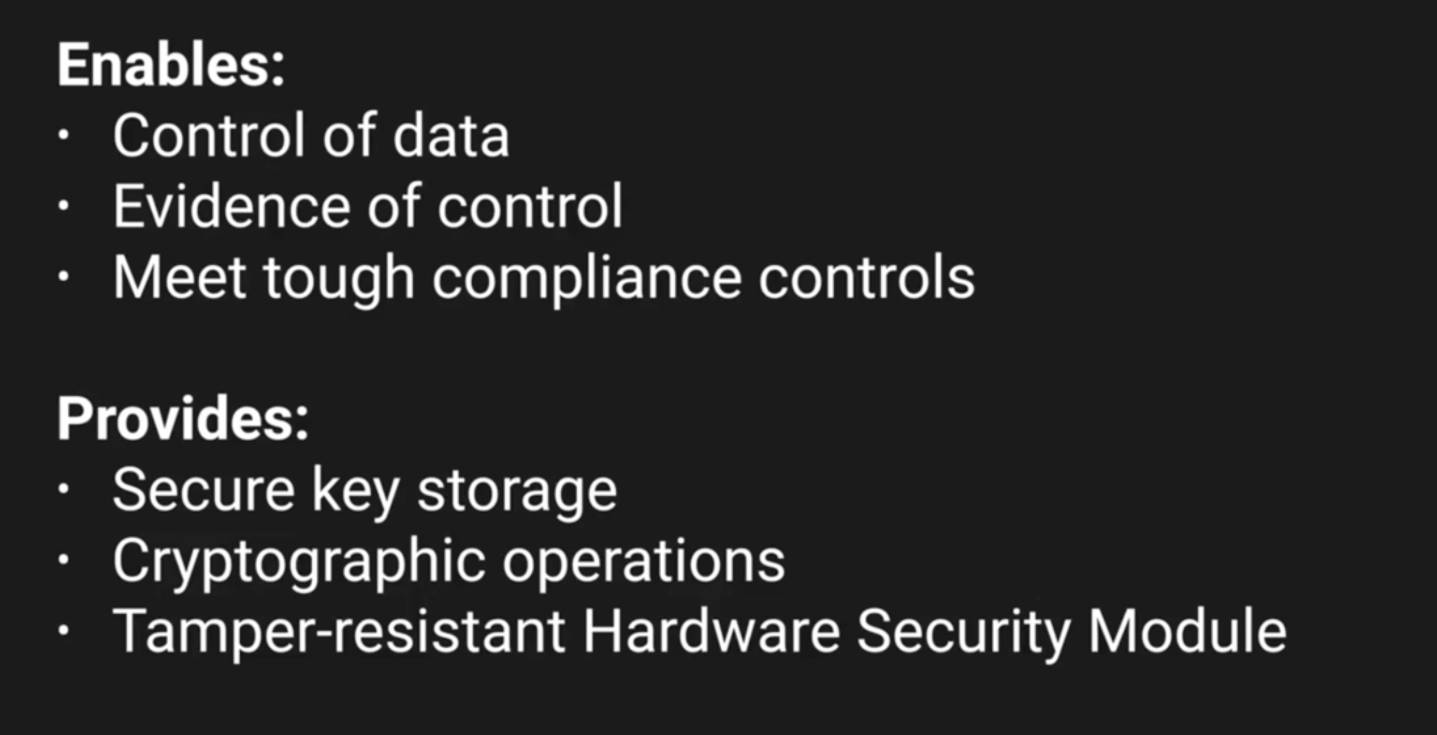

Slide 27
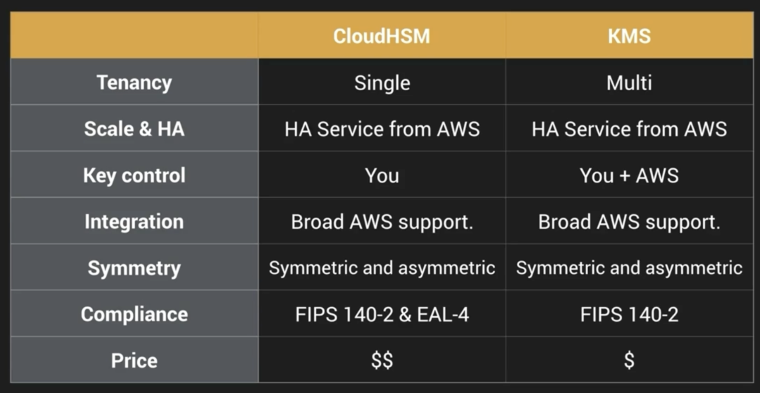

Slide 28
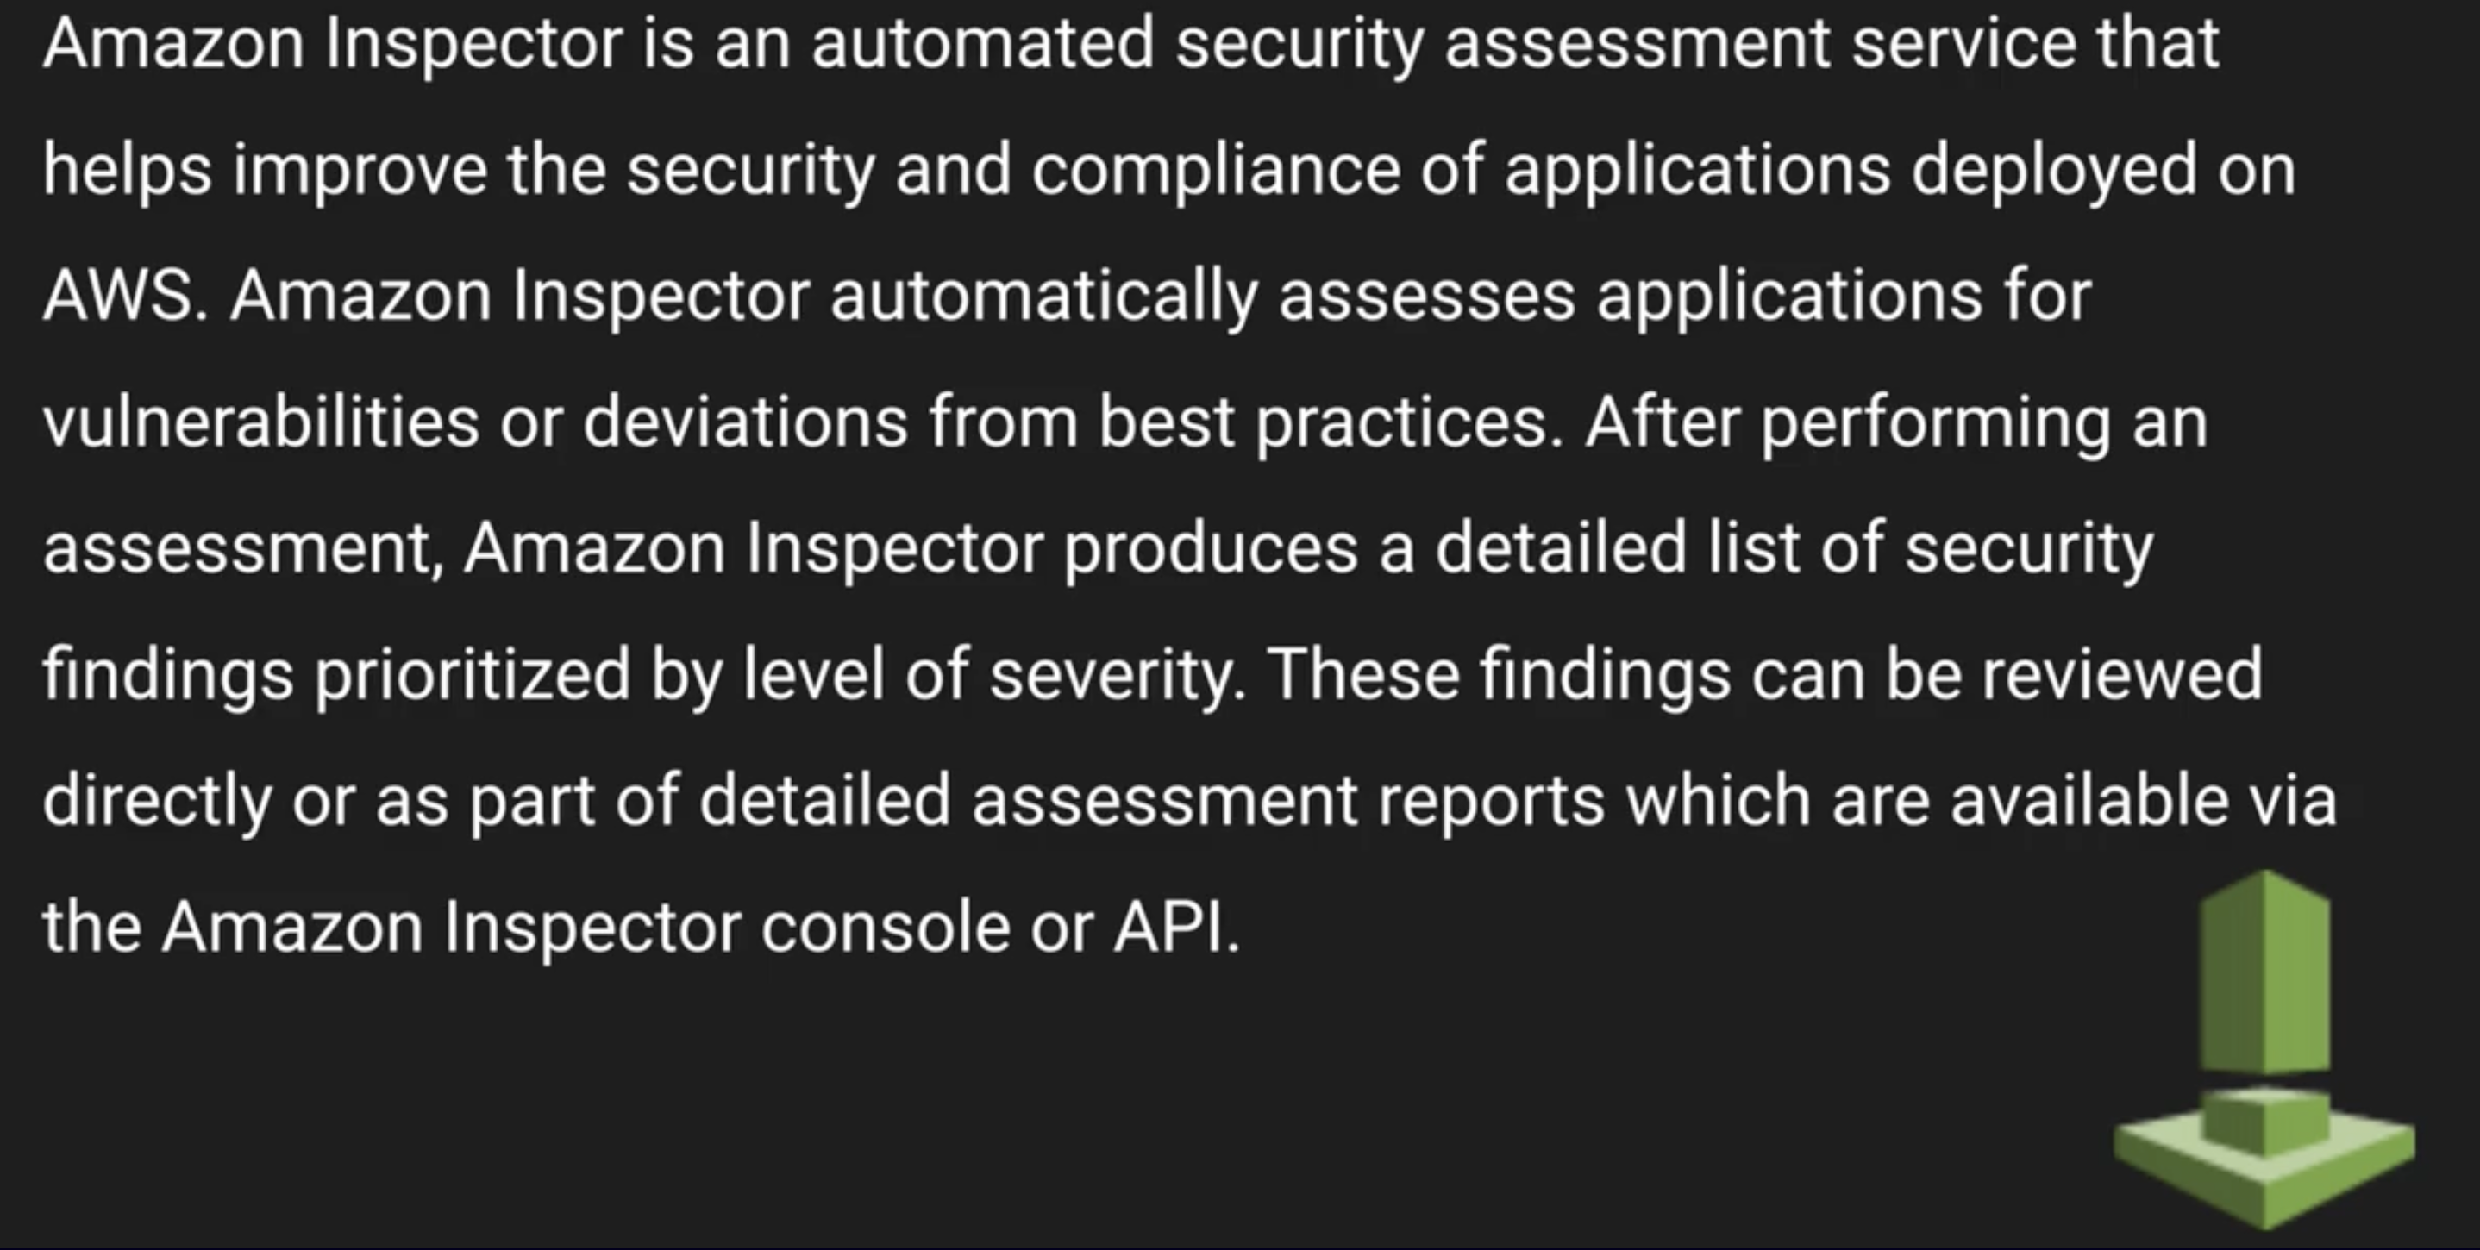
AWS Inspector Vs AWS Trusted Advisor
What is AWS Inspector:

Slide 29
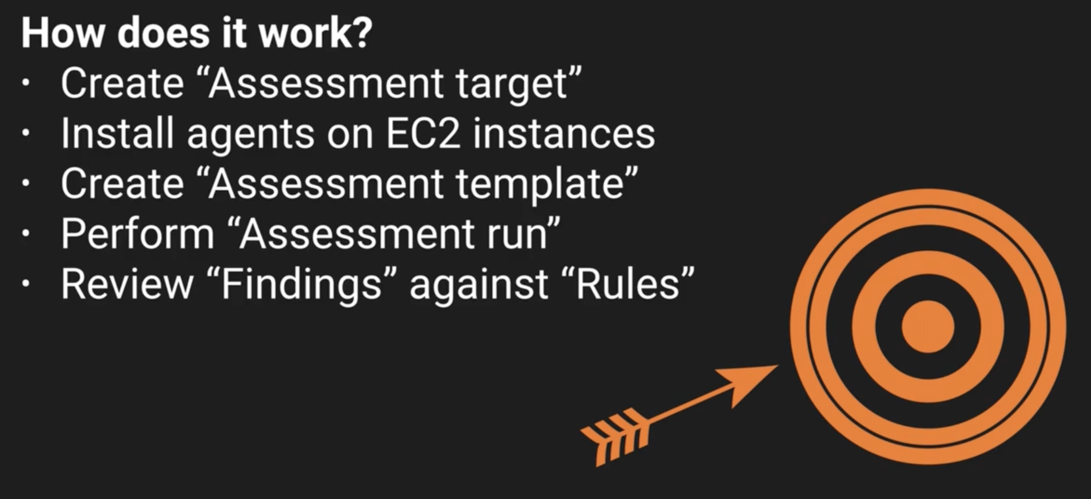

Slide 30
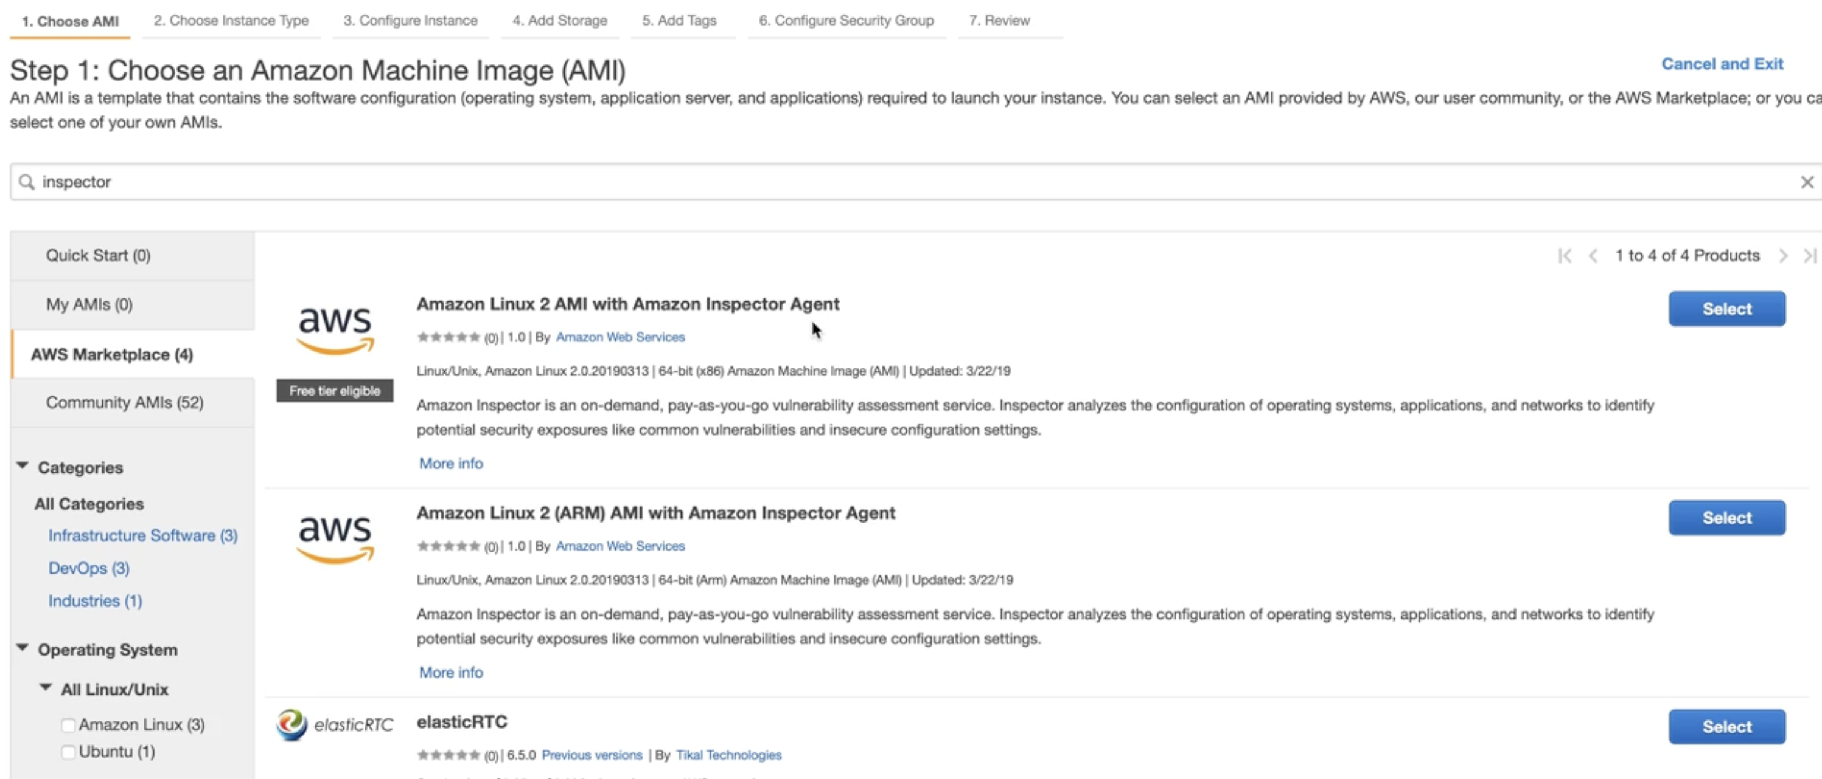

Slide 31
To test your applications and infrastructure with AWS Inspector, you will need to follow these steps:
Create an assessment target: You can create an assessment target to specify the resources you want to assess, such as EC2 instances or VPCs.
Create an assessment template: An assessment template defines the rules and settings that will be used to assess your resources. You can choose from pre-defined rules packages or create custom rules.
Start an assessment run: Once you have created an assessment target and template, you can start an assessment run to scan your resources for potential vulnerabilities.
Review findings: After the assessment run is complete, you can review the findings in the AWS Inspector console. AWS Inspector provides a detailed report of the vulnerabilities it has found, along with recommendations on how to fix them.
Remediate vulnerabilities: Finally, you will need to remediate any vulnerabilities that AWS Inspector has found. You can use the recommendations provided in the report to fix the issues.
By regularly running assessments with AWS Inspector, you can help ensure that your applications and infrastructure are secure and protected from potential security threats.

Slide 32
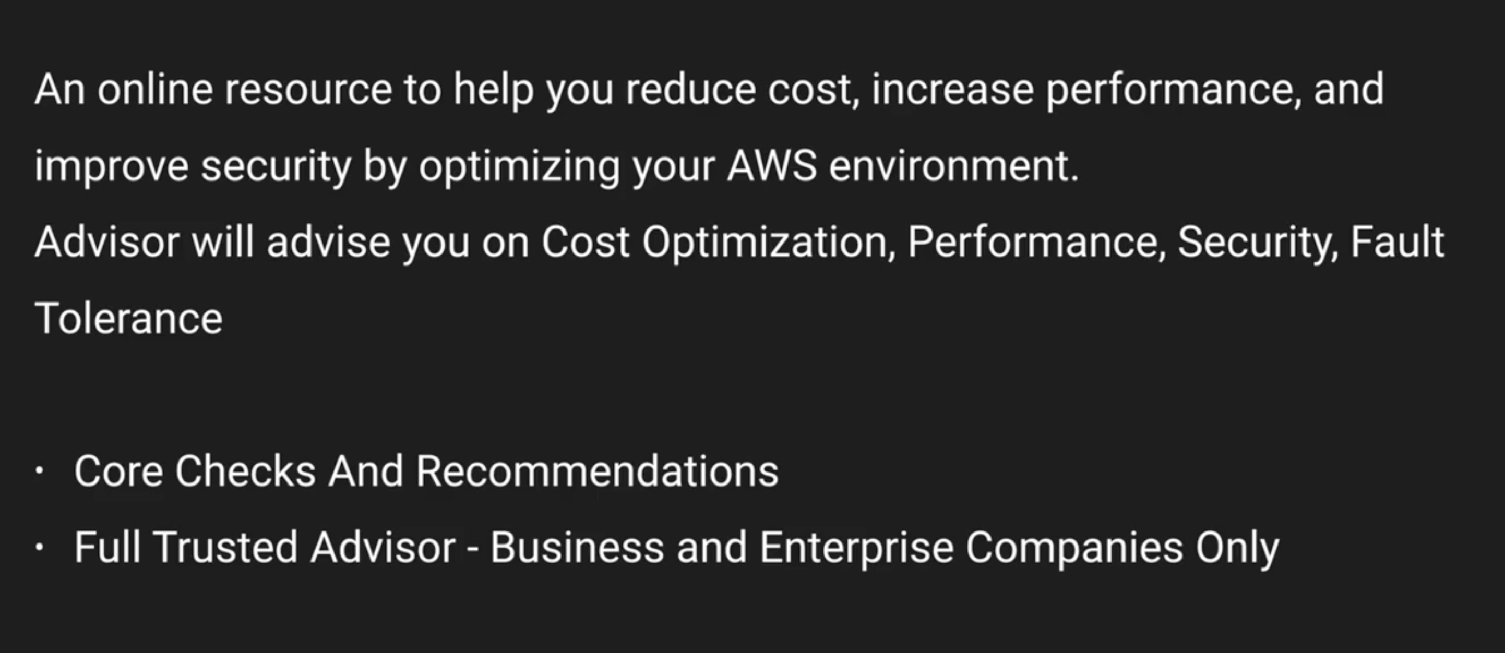
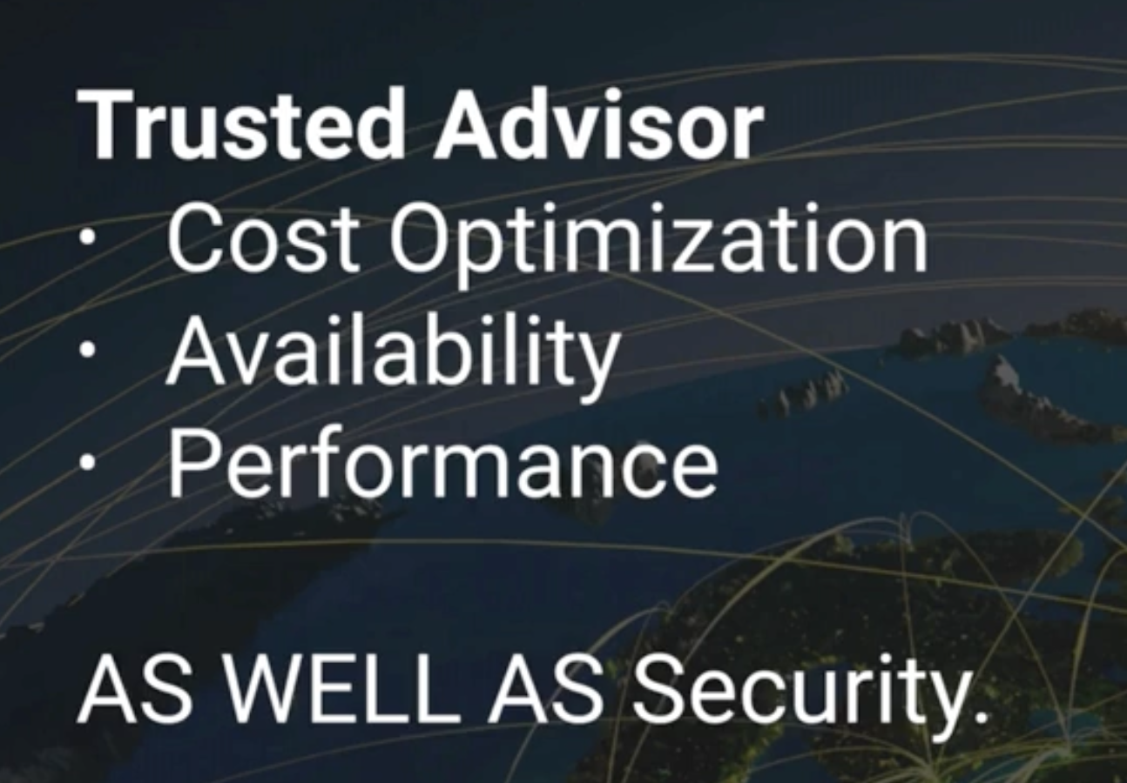
What is Trusted Advisor

Slide 34
Infrastructure Security

Slide 35
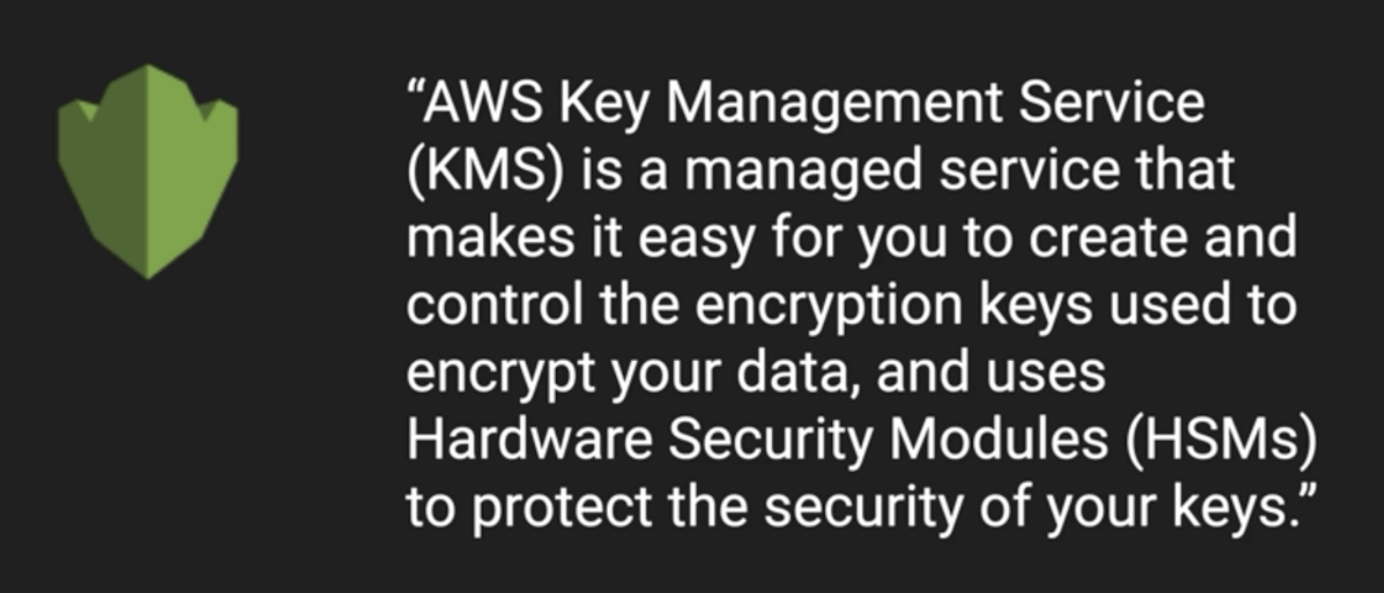
KMS (Key Management Service)

Slide 36
AWS Key Management Service (KMS) is a managed service that makes it easy to create and control the encryption keys used to encrypt your data. KMS is integrated with many other AWS services, such as Amazon S3, EBS, and RDS, to provide a seamless and secure way to encrypt your data.
KMS works by providing you with two types of keys: customer master keys (CMKs) and data encryption keys (DEKs). CMKs are used to encrypt and decrypt DEKs, while DEKs are used to encrypt and decrypt your data.

Slide 37
Create 3 IAM users
Console Access – Autogenerate Password
Permission not set
Copy username and password in notepad
Create 2 IAM Groups
- AdministratorGroup - ElonMask
- FinanceGroup (S3FullAccess, ReadOnlyAccess) – John, user 3

Slide 38
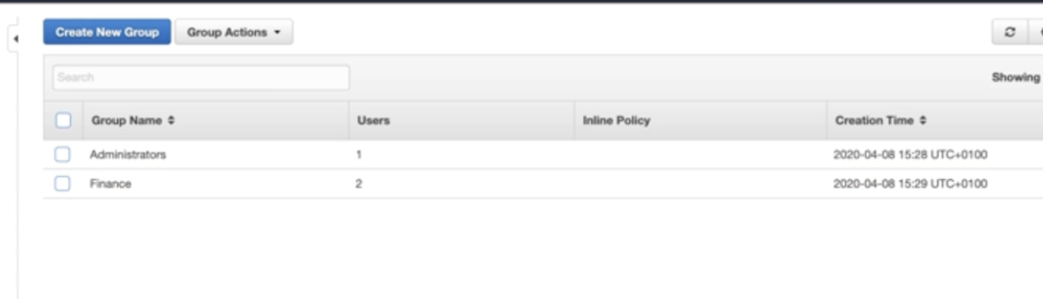
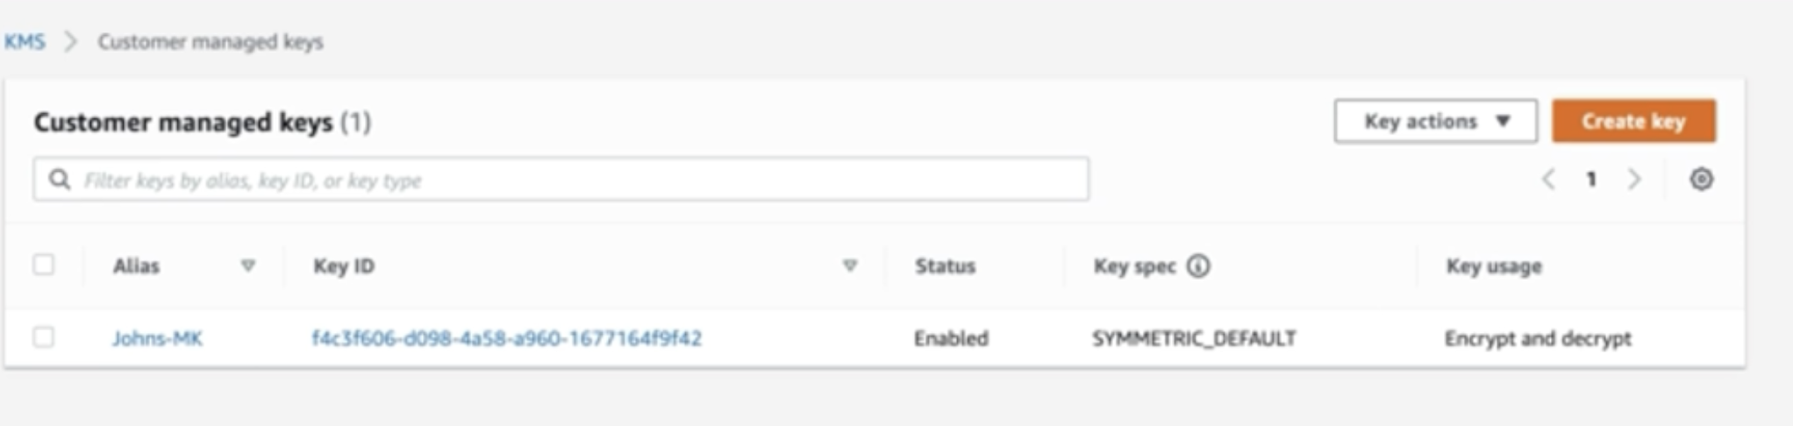

Slide 39
Go to KMS service
It is region based
Create Key
- Symmetric key (Single key used for encrypt and decrypt) : s3
- Asymmetric (2 keys(public and private to be used) :ec2
Click on Next
Enter Alias -> John-Mk
Tags – Department - FInance

